Slide 1

Post – 18
Choices, choices

Slide 2
Starter
Unscramble the words below.
EPMOTLYMEN
PAPTERNICEHISP
PAG EARY
GREEDE
Get ready to share with the class!
Notes:
Teacher’s notes:
Starter activity: The purpose of this activity is to introduce examples of Post 18 pathways. The answers are on the next slide. Depending on the time and ability level of the class, you could split the class into four, focusing on one of the words.
Keyword: Pathway is a route or way of achieving a goal or a Post 18 option. For example, it could be a specific career pathway and include a series of structured and connected steps to achieve your goals

Slide 3
Starter
Here are the answers!
EMPLOYMENT
APPRENTICESHIP
GAP YEAR
DEGREE
There are many pathways available when you finish College or sixth form at 18.
There is no right or wrong answer!
Notes:
Teacher’s notes: Emphasise why the words are relevant. Share that they are different types of Post 18 pathways. Explain that you will discuss these in more detail during this session and there is no right or wrong Post 18 pathway. The important thing is to be informed about the options available and make the best choice for you.

Slide 4
What options are available? (5 mins)
A degree at a university is more academic.
An apprenticeship is more practical.
A degree apprenticeship is a mix of both!
FE courses at Colleges are available in a variety of subjects.
A job is something you can gain experience in straight away.
A gap year is an opportunity to work, travel and take time out of education.
There is no right or wrong answer!
Notes:
Teacher’s notes: The purpose of this slide is to break down different options in more detail.
Use the stretching exercise below and ask students to add further information about each of these headings. Don't spend too long on this; each pathway is covered in more detail later.
Stretching exercises:
Degree: A degree has a more academic focus and will often last for 3 – 4 years. You can study in different ways, including distance learning, part-time or full-time living at home or on campus.
Apprenticeship: An apprenticeship is more practical. You can use the Unifrog Apprenticeship tool to search for available Apprenticeships. Apprenticeships include some level of assessment but not in the same way as a traditional university degree.
Degree apprenticeship: a blend of both an academic degree and a practical apprenticeship. You often work and study at the same time.
FE courses: available in a variety of subjects, such as practical-based courses.
Job: You could get a job straight away. You may decide to get a job while completing a course part-time (this could be a degree or another part-time course). Equally, you could work full time and gain experience in a career field or take advantage of employer based training programmes.
Gap year: A gap year is an opportunity to work, travel, and take time out of education. You may decide to get a job or complete a short course such as an art foundation, or language course.
There is no right or wrong answer!

Slide 5
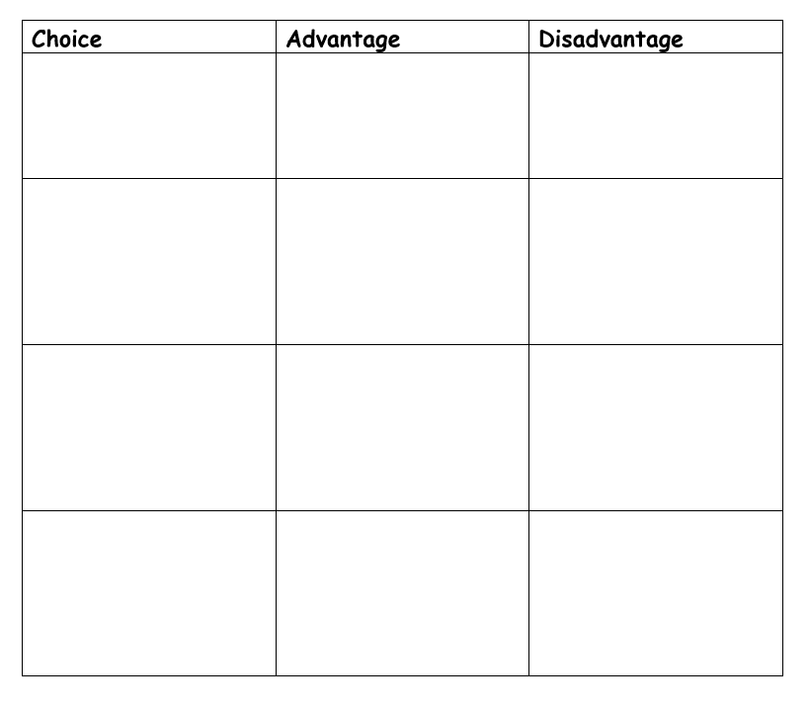
Lets start to compare our options

Slide 6
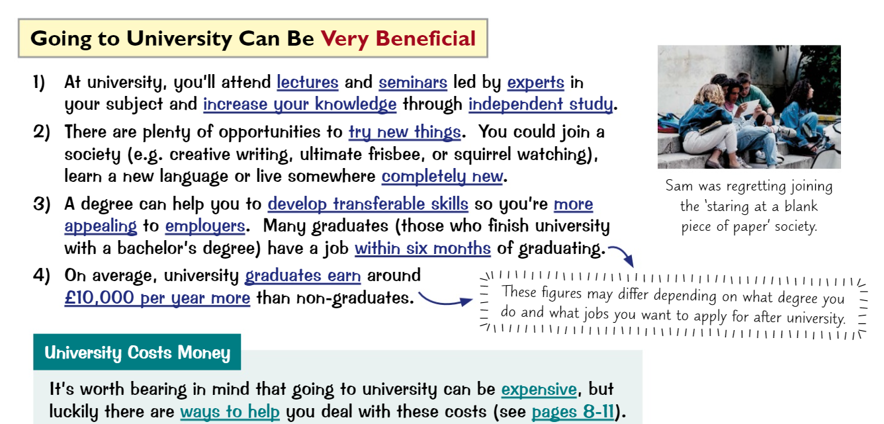
University
MORE ON THIS IN A LATER XESSION
MORE ON THIS IN ANOTHER SESSION

Slide 7
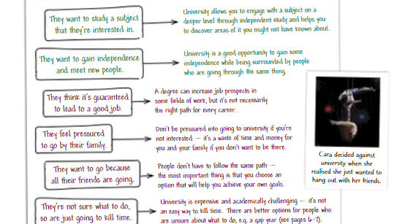
University

Slide 8
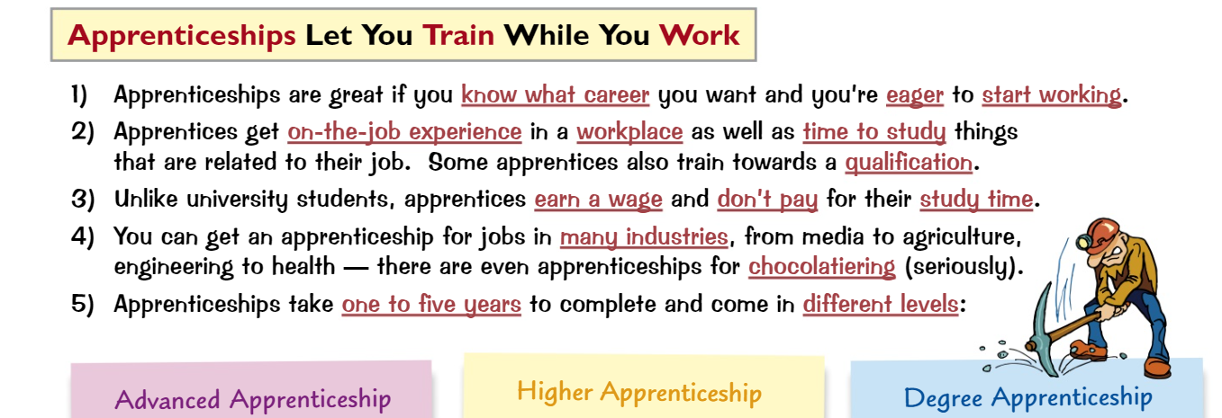

Slide 9
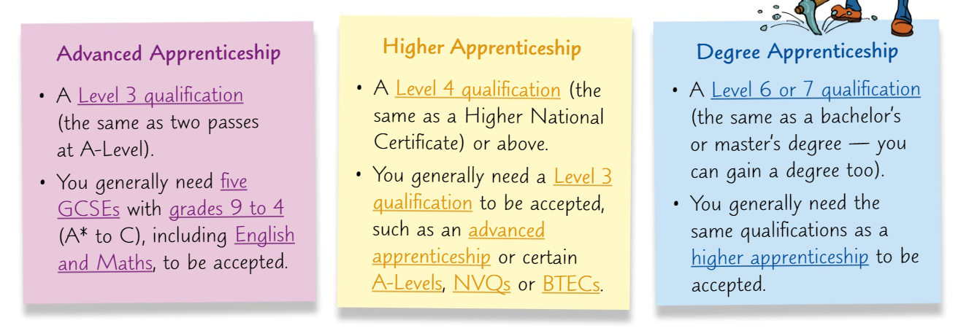

Slide 10
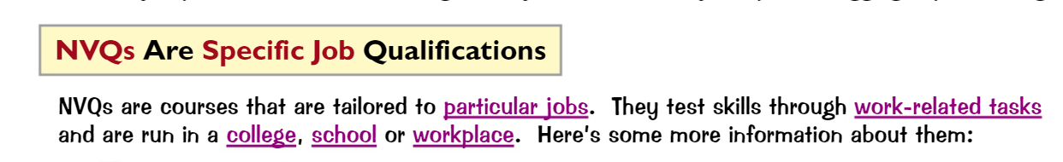
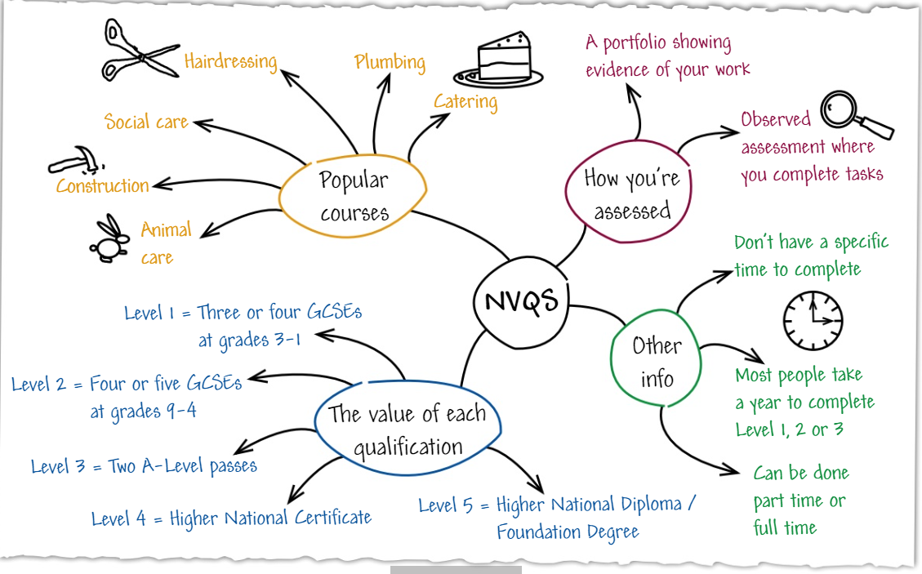

Slide 11
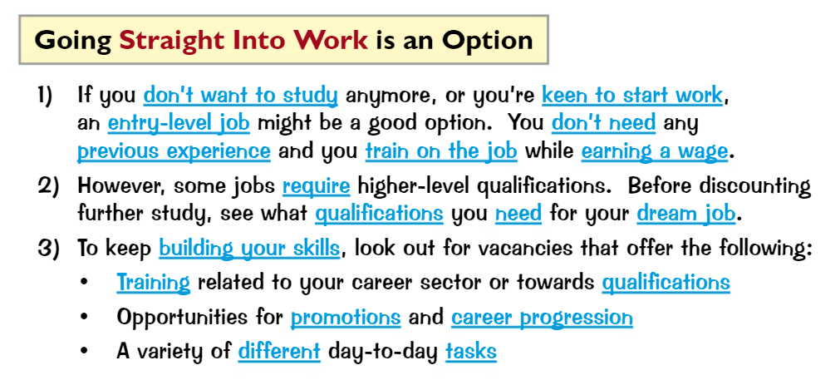

Slide 12


Slide 13

Task for this week
Log on to Unifrog and read the Know-how library
guide on ‘College, Apprenticeships or University?’
Notes:
Teacher’s notes: to discuss in more detail the benefits of going to Universi

