Slide 1

How too guide

Slide 2

At Trinity we use Unifrog to help manage our post – 18 intentions and applications
Watch this video on how to use Unifrog.
Then you will have the remaining sessions in form time this week to complete a tick list of tasks to help you prepare. This will be posted on SMHW.
Your form teacher will be able to track your progress so will be able to see if you have completed the tasks you have ticked
https://www.youtube.com/watch?v=CXGB4h3Hn44
Notes:
The link should work by clicking the video but in case not I have added the link for you to cut and paste

Slide 3
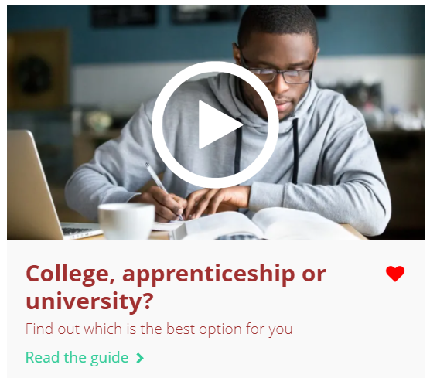
Task for this week
Log onto Unifrog
Complete a personality profile.
Complete the interests quiz.
Explore MOOCS – some of you have already done this
Watch the Know-how library
guide on ‘College, Apprenticeships or University?’
Start to fill in your activity profile. Moocs? Summer schools, virtual work experiences? Add them now so you don’t forget that you have done them
Notes:
Teacher’s notes: make sure students understand that they personality quiz and interests quiz are important – they have always wanted to be a Dr but do they really understand what it entails and is there personality suited to it?

