Slide 1

My current post-18 intentions

Slide 2
You should have completed the following:
Logged onto Unifrog
Completed a personality profile.
Completed the interest's quiz.
Explore MOOCS
Watch the Know-how library guide on ‘College, Apprenticeships or University?’
Started to fill in your activity profile.

Slide 3
This week we will
Start to explore our post 18 intensions.
Made some choices about University degree's vs apprenticeships
Make a long list of possible Uni courses and places we may want to study
Devise a plan A and a plan B for our current thoughts and ideas

Slide 4
Made some choices about University degree's vs apprenticeships
You do not have to make your final choice now
In year 13 many students applied for both to keep their options open

Slide 5
You can choose your University first or your course. There is no right or wrong way.
What and where?
You might have a set course in mind and do not care where you go to study that.
You might want to stay at home (more on student finance later)
Then find Universities near Manchester and then look for courses you are interested in.
How will you commute?
Be prepared to make some compromises

Slide 6


Slide 7
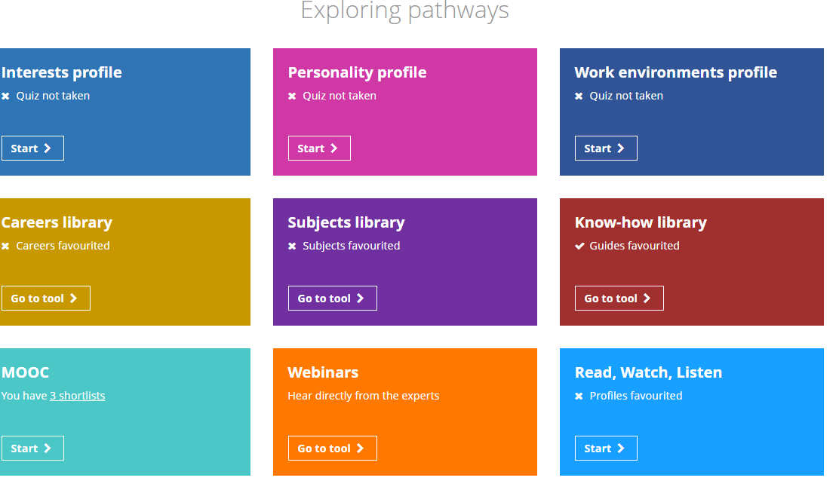
Exploring Pathways
Log into Unifrog
Scroll down and click on the PURPLE subject library box
Use keyword search or by related to A level topics or by characteristics/interests
Notes:
The link should work by clicking the video but in case not I have added the link for you to cut and paste

Slide 8
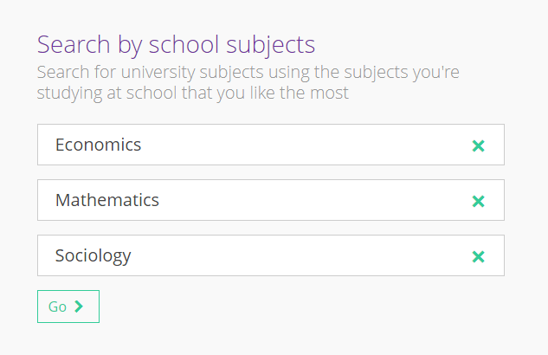
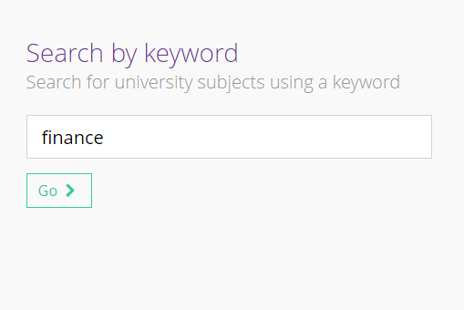
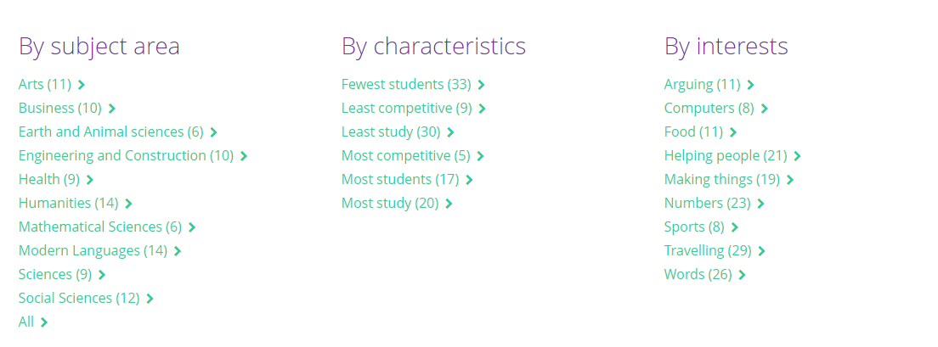

Slide 9
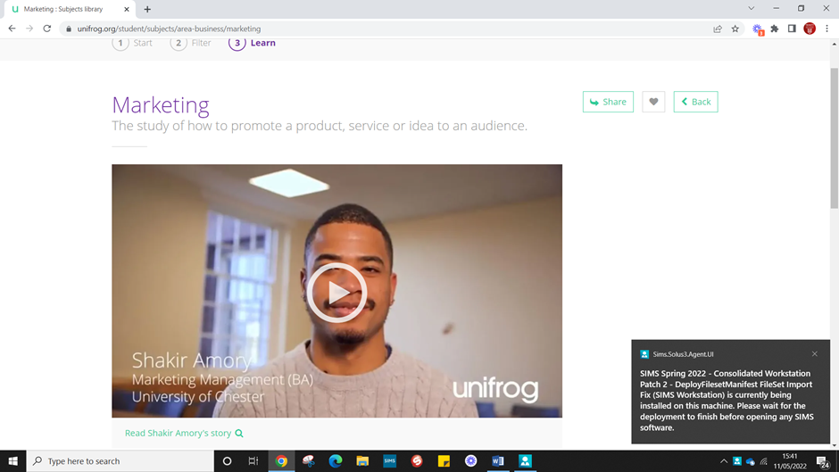
Watch some videos – are you sure the course you are think of is really what you want to do?

Slide 10
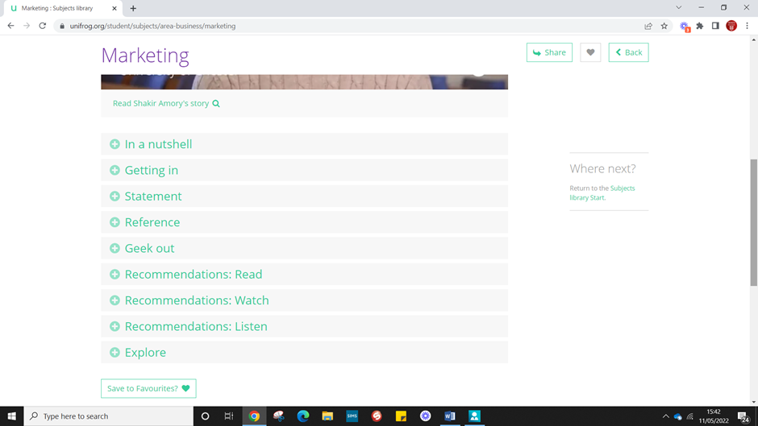
Scroll down and check out the more specific details if you are interested
Getting in – what grades do you need?
Examples of personal statements
Good references – your class teachers will be able to see what you have applied for so let them know to check this section out!
Wider reading/podcasts to boost application
Geek out – real focus in detail on certain areas so you realize what they are signing up for!

Slide 11
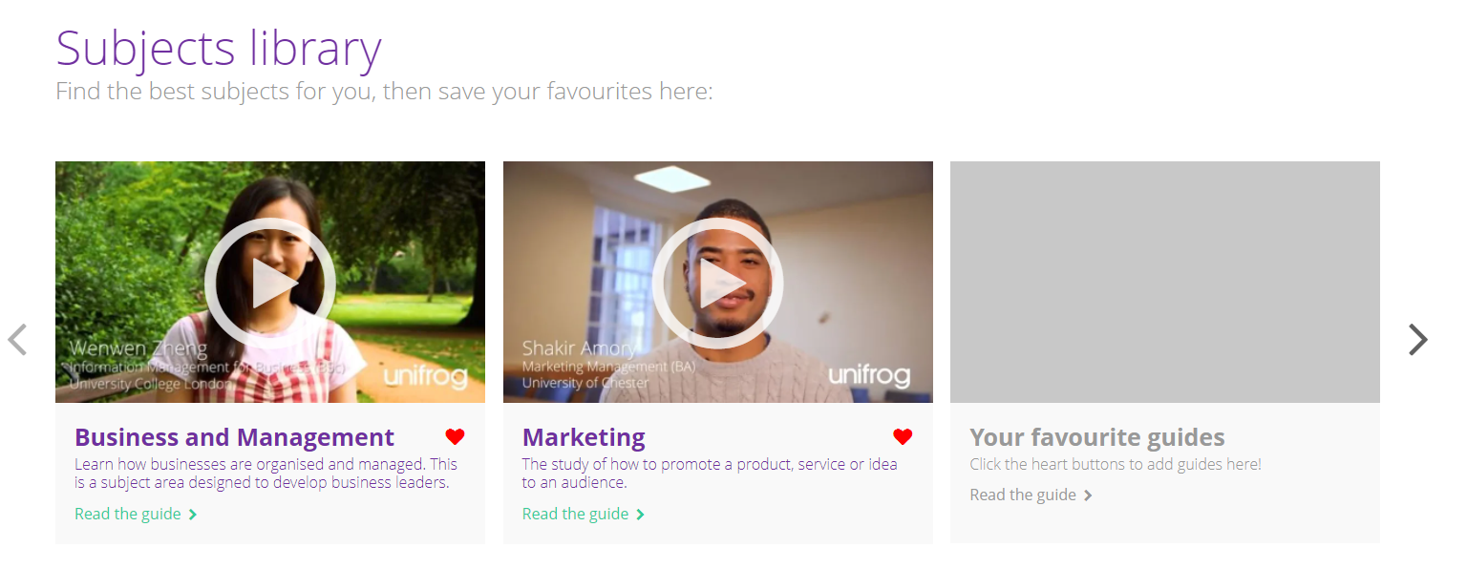
If you like the look of the course, you can add to favorites and then they will be stored for you to back to and look again the future

Slide 12
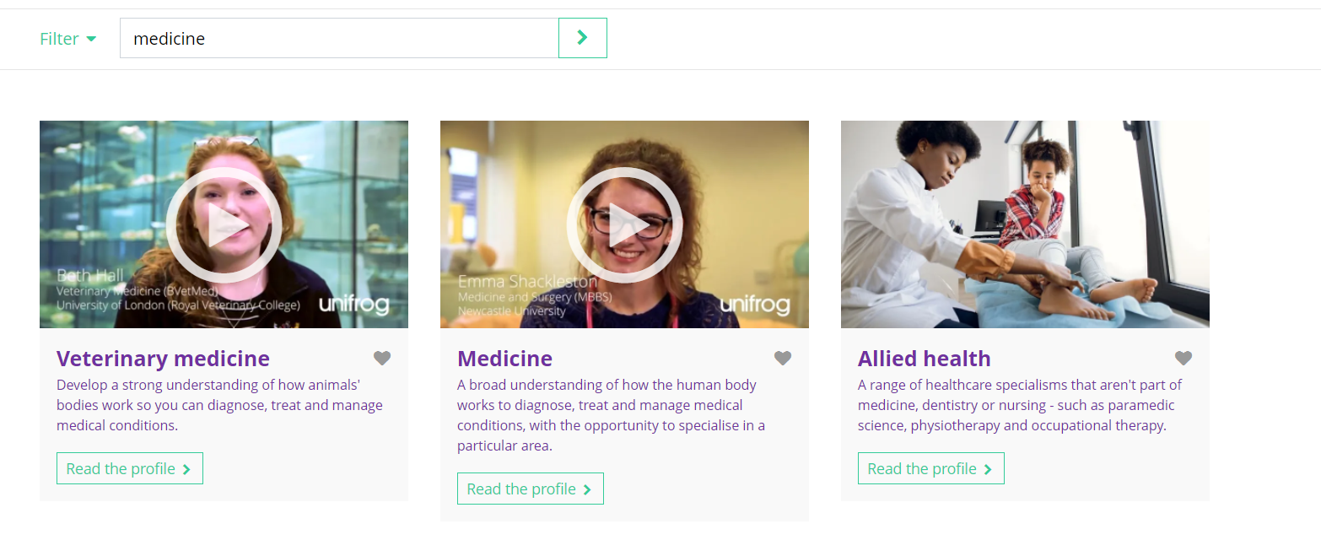
Some courses are very competitive or only allow you to put in 4 choices.
What is your back up plan?

Slide 13
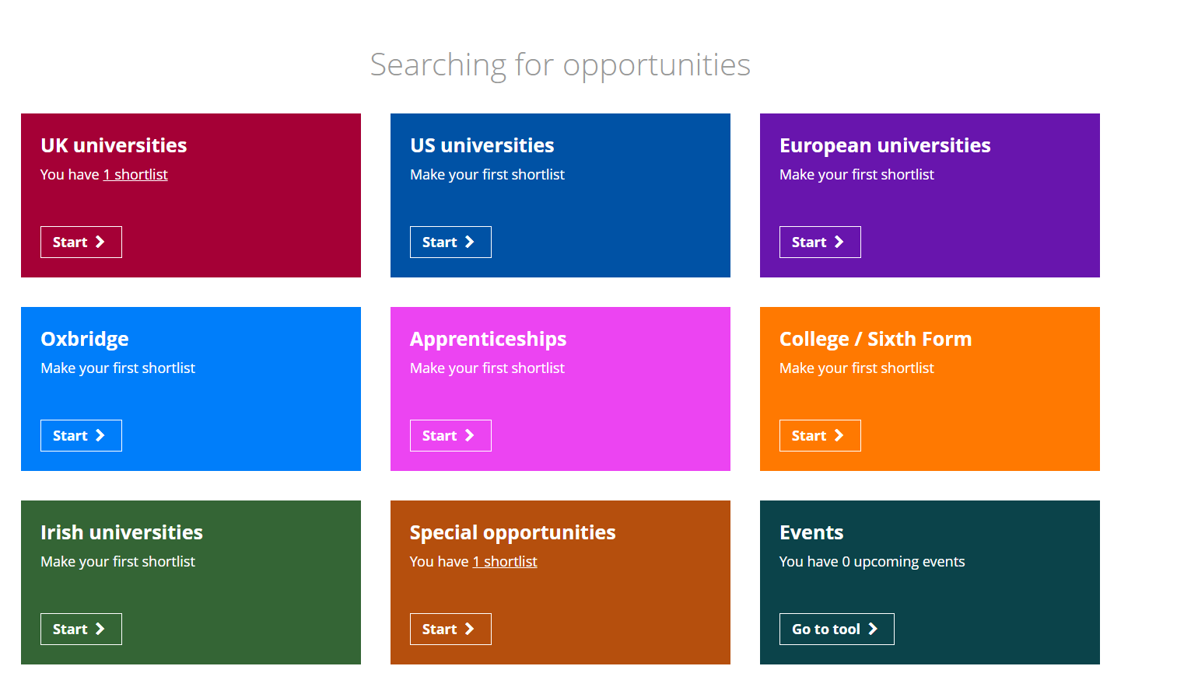
Choosing your University
You are then taken through a series of questions to help narrow down your choices.

Slide 14
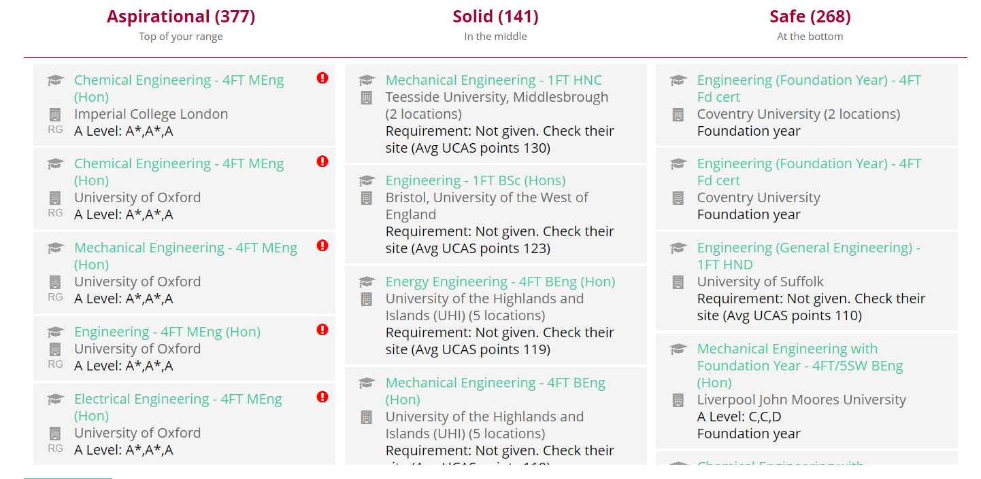
They will then give you a series of possible options to explore that will allow you to make a range of aspirational and "safe" choices

Slide 15

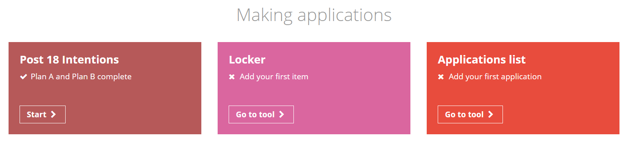
Start to plan
Scroll down and click "start" on the post 18 intensions tab
Start a plan to formalize your thoughts
Be prepared for your plans to change
What to do next?: Your Intentions
Notes:
Teacher’s notes: The purpose of this slide is for students to add their intentions using the Post 18 Intention tool.
Instructions
Login to Unifrog and scroll down to the Post 18 Intentions tool (it is near the bottom of the Student Side homepage).
It will ask them to enter their ‘dream career’. They can write anything in this free form text box and even put ‘I don’t know’ as a career choice.
On the next page, they fill in a few questions for Plan A and Plan B pathways. They can put ‘I don’t know, but encourage them to put something down based on what they learned today.
The tool may suggest they use one of the search tools (such as the university or apprenticeship tool). If you have time, they can do this in the lesson. If not, they can explore it in their homework.
If you feel confident you could share your screen with the class and demo adding a fake student pathway on the Post 18 Intentions tool.
Emphasise to students that they can keep logging in to updating the tool as their plans develop.
You can view your students’ Post-18 Intentions on Unifrog by going to Advanced on your teacher homepage, selecting the year group, then clicking Sort by > P18 Intentions. You can also download them for record keeping via the Downloads button at the bottom of the Advanced page.

Slide 16
Tasks for this week:
Identify courses that interest you – add them to your favorite's on unifrog
Identify places you may want to study - add them to your short list on unifrog
Start a plan A in the post-18 intensions tab
Extension: Check out the courses you have short listed on the actual university websites. What are the units they study? What are the entry requirements?

