Slide 1

Introduction to student finance

Slide 2
What you should have done this week:
Identify courses that interest you – added them to your favorite's on unifrog
Identify places you may want to study - added them to your short list on unifrog
Started a plan A in the post-18 intensions tab
Extension: Checked out the courses you have short listed on the actual university websites. What are the units they study? What are the entry requirements?

Slide 3
Today we will:
Start to explore student finance

Slide 4


The costs of going to University
Short UCAS video to watch

Slide 5
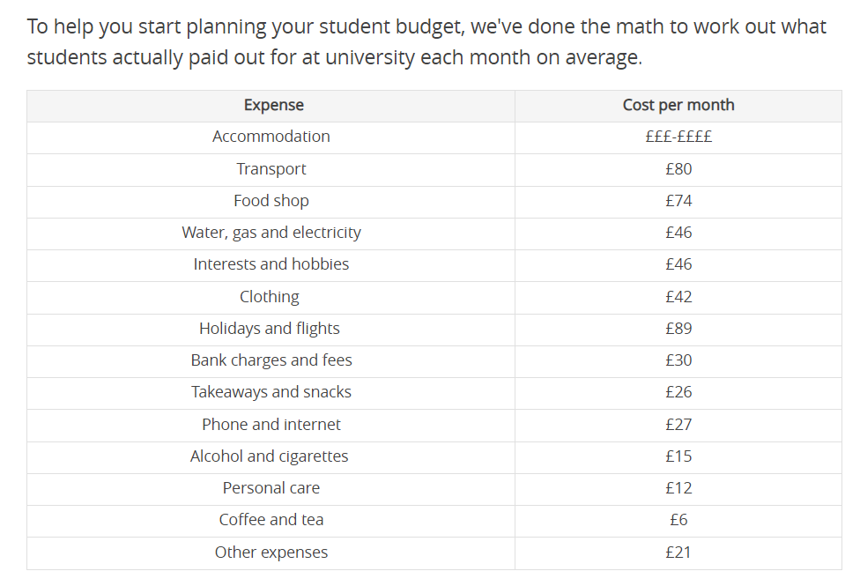
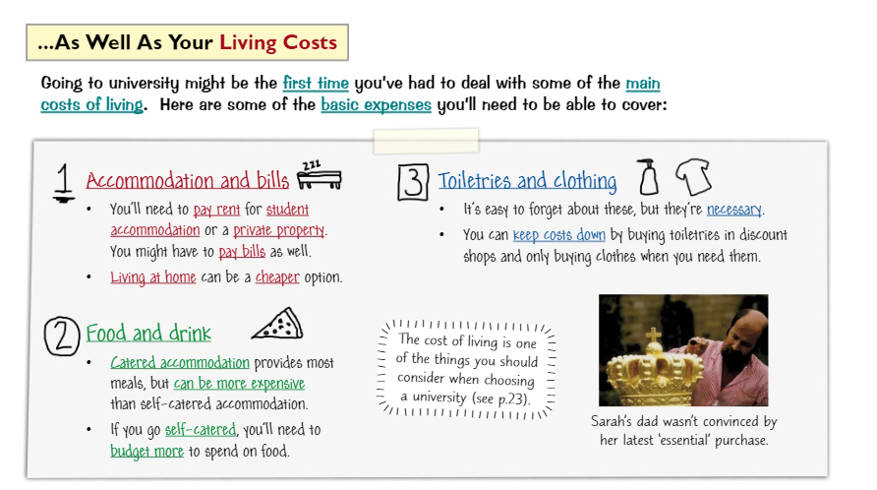

Slide 6
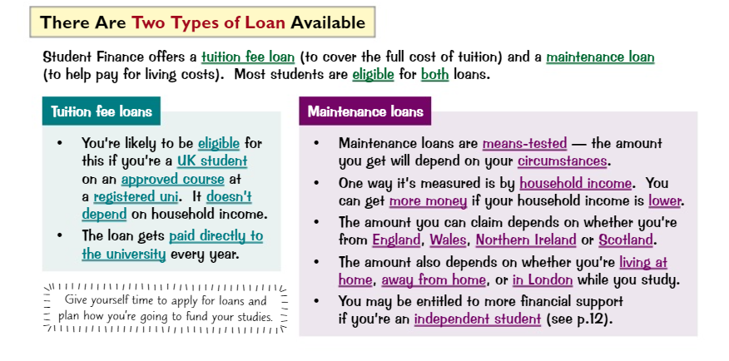

Slide 7
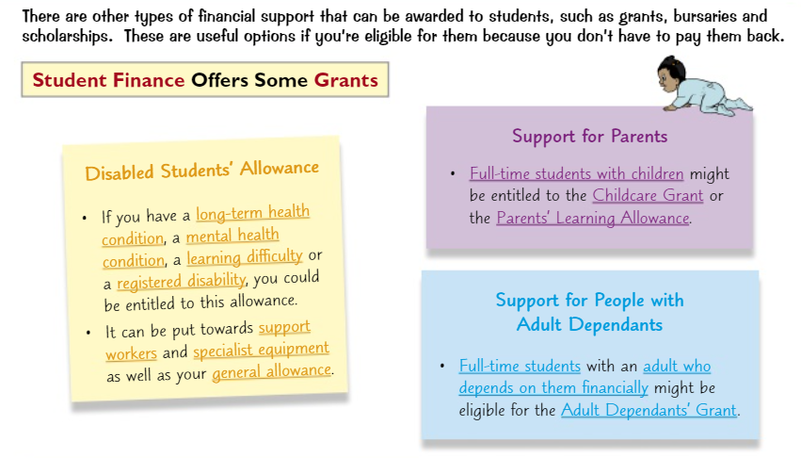

Slide 8

We will spend more time on student finance in year 13 but this should help you to decide if you can afford to move away from home.

