Slide 1

Apprenticeships: finding the best fit

Slide 2

What do you know already? (2 mins)
Chat with your table or the person next to you:
  What do you know about apprenticeships?
  Do you know anyone who has taken one?
  What’s the point of them?
Notes:
Teacher’s notes: Starter activity: students discuss their thoughts on the questions. There is more information on the next slide. Take feedback at the end, but keep the time you allocate to this brief.
Possible answers:
Students might know about earning as you learn, or that this is a vocational option.
Some students might have family or friends who have taken an apprenticeship and can share their experiences.
Students might suggest things like: gives you the chance to earn straight away, gives you the opportunity to learn new skills, doesn’t require a degree, can be combined with a degree, etc.

Slide 3
What is an apprenticeship? (1 min)
Apprenticeships are jobs in training. They allow you to gain a qualification, new skills, and valuable experience - all whilst earning a wage.
It used to be the case that apprenticeships were generally in trades like Construction and Engineering, but now there’s a huge range to choose from - from Floristry to Law – and you can even earn a degree through some apprenticeships.
Notes:
Teacher’s notes:
Keyword: apprenticeships – these are opportunities for 16+ year olds to start working straight from school whilst earning a wage and a qualification.

Slide 4
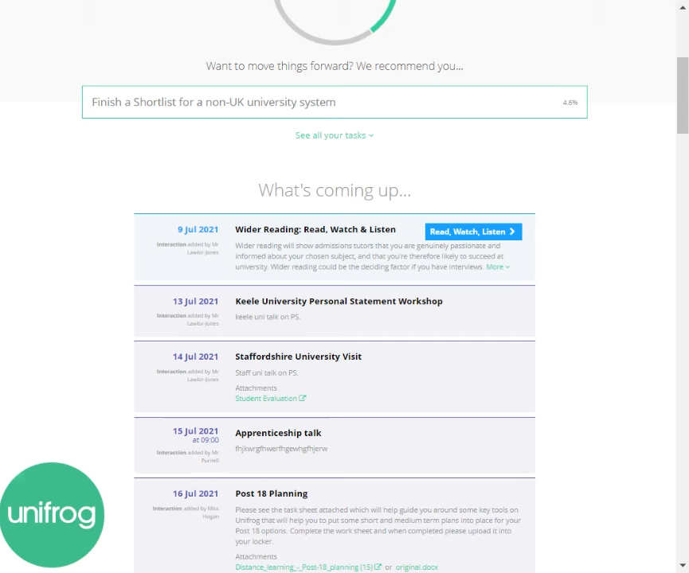
Finding the best fit
Watch this video to learn how to use the Unifrog Apprenticeships tool!
Notes:
Teacher’s notes: This slide contains a short video on how to navigate the Apprenticeships tools on Unifrog.
Apprenticeships tool Loom video link: https://www.loom.com/share/8857db7c21a148a29d2af7d4edeea964

Slide 5
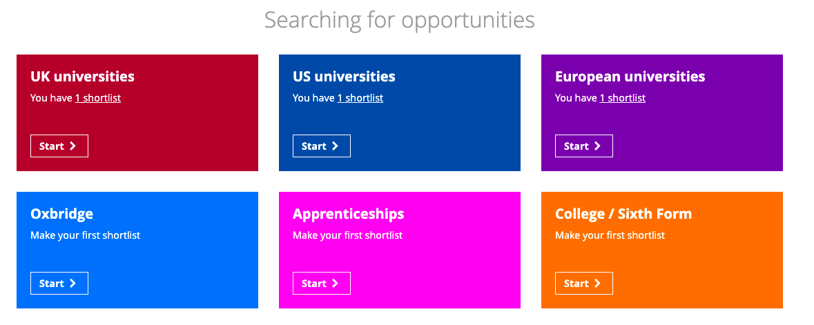
Finding the best fit
Log into Unifrog, scroll down to the Searching for opportunities section, and find the Apprenticeships tool.
Notes:
Teacher’s notes: The opportunities on this tool are updated every 24 hours. They are split up into levels so you may need to remind students to only look at opportunities relevant to them. Encourage students to do as much research as possible before they choose their opportunities, using the questions on the previous slide to support them.
If you want to demonstrate this tool live, you can by clicking Student side>Apprenticeships.
You can track students’ shortlists by clicking Advanced > Select the year group > Sort by > Apprenticeship shortlists
Students must save their shortlist in order for you to track it. If they don’t, their progress won’t be saved.

Slide 6
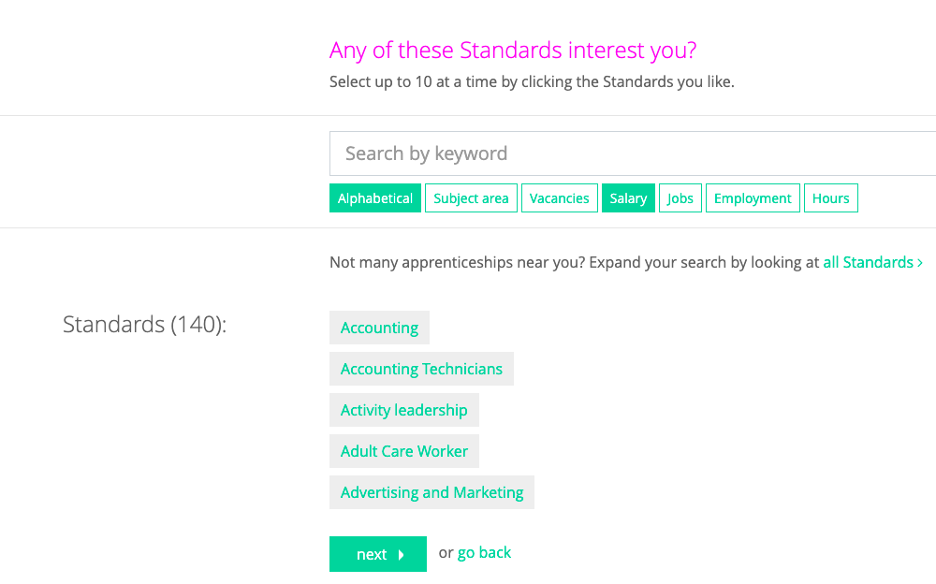
Finding the best fit
Use the standards, the rank and filter buttons, and the keyword search tool to find at least five opportunities that you find interesting.
Notes:
Teacher’s notes:
The opportunities on this tool are updated every 24 hours. They are split up into levels so you may need to remind students to only look at opportunities relevant to them. Encourage students to do as much research as possible before they choose their opportunities, using the questions on the previous slide to support them.
If you want to demonstrate this tool live, you can by clicking Student side>Apprenticeships.
You can track students’ shortlists by clicking Advanced > Select the year group > Sort by > Apprenticeship shortlists
Students must save their shortlist in order for you to track it. If they don’t, their progress won’t be saved.

Slide 7
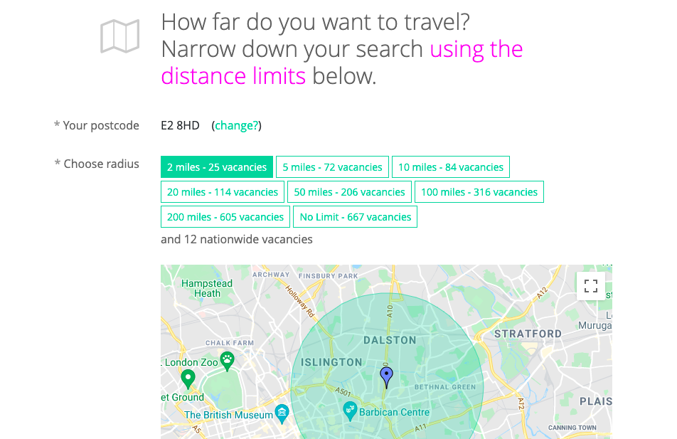
Finding the best fit
Select how far you want to travel for your apprenticeship using this handy map tool.
Notes:
Teacher’s notes:
The opportunities on this tool are updated every 24 hours. They are split up into levels so you may need to remind students to only look at opportunities relevant to them. Encourage students to do as much research as possible before they choose their opportunities, using the questions on the previous slide to support them.
If you want to demonstrate this tool live, you can by clicking Student side>Apprenticeships.
You can track students’ shortlists by clicking Advanced > Select the year group > Sort by > Apprenticeship shortlists
Students must save their shortlist in order for you to track it. If they don’t, their progress won’t be saved.

Slide 8
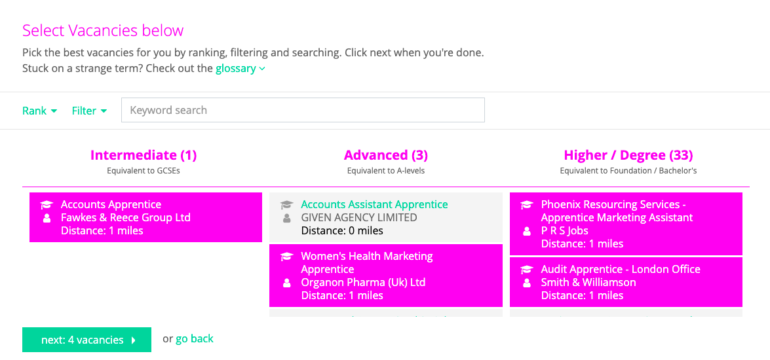
Finding the best fit
A longlist has been created for you. Select the opportunities that you think are a best fit for your goals to narrow it down to a shortlist.
Notes:
Teacher’s notes:
The opportunities on this tool are updated every 24 hours. They are split up into levels so you may need to remind students to only look at opportunities relevant to them. Encourage students to do as much research as possible before they choose their opportunities, using the questions on the previous slide to support them.
If you want to demonstrate this tool live, you can by clicking Student side>Apprenticeships.
You can track students’ shortlists by clicking Advanced > Select the year group > Sort by > Apprenticeship shortlists
Students must save their shortlist in order for you to track it. If they don’t, their progress won’t be saved.

Slide 9
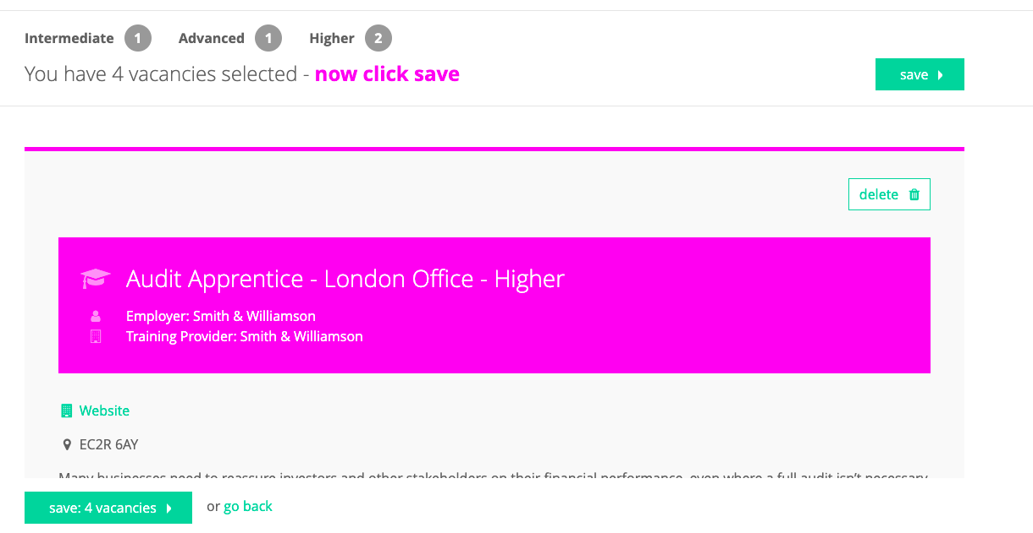
Finding the best fit
Review your shortlist and save. The final shortlist will be emailed to you.
Notes:
Teacher’s notes:
The opportunities on this tool are updated every 24 hours. They are split up into levels so you may need to remind students to only look at opportunities relevant to them. Encourage students to do as much research as possible before they choose their opportunities, using the questions on the previous slide to support them. Remind students to look up the job role in the Careers library and check out the website for the employer and training provider to find out more information.
Save your shortlist.
If you want to demonstrate this tool live, you can by clicking Student side>Apprenticeships.
You can track students’ shortlists by clicking Advanced > Select the year group > Sort by > Apprenticeship shortlists
Students must save their shortlist in order for you to track it. If they don’t, their progress won’t be saved.

