Slide 1

Special opportunities

Slide 2
The Benefits
Support for your university application
    Find opportunities that can help you get into university and pay for it too.
Expectations met
    Filter opportunities by location, circumstance, merit and other personal eligibility criteria.
Application support
    Full information & guidance on what criteria makes you eligible and how to apply for the opportunities you have selected.

Slide 3
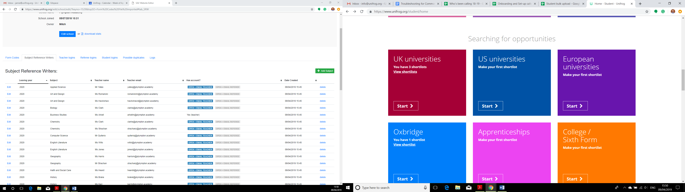
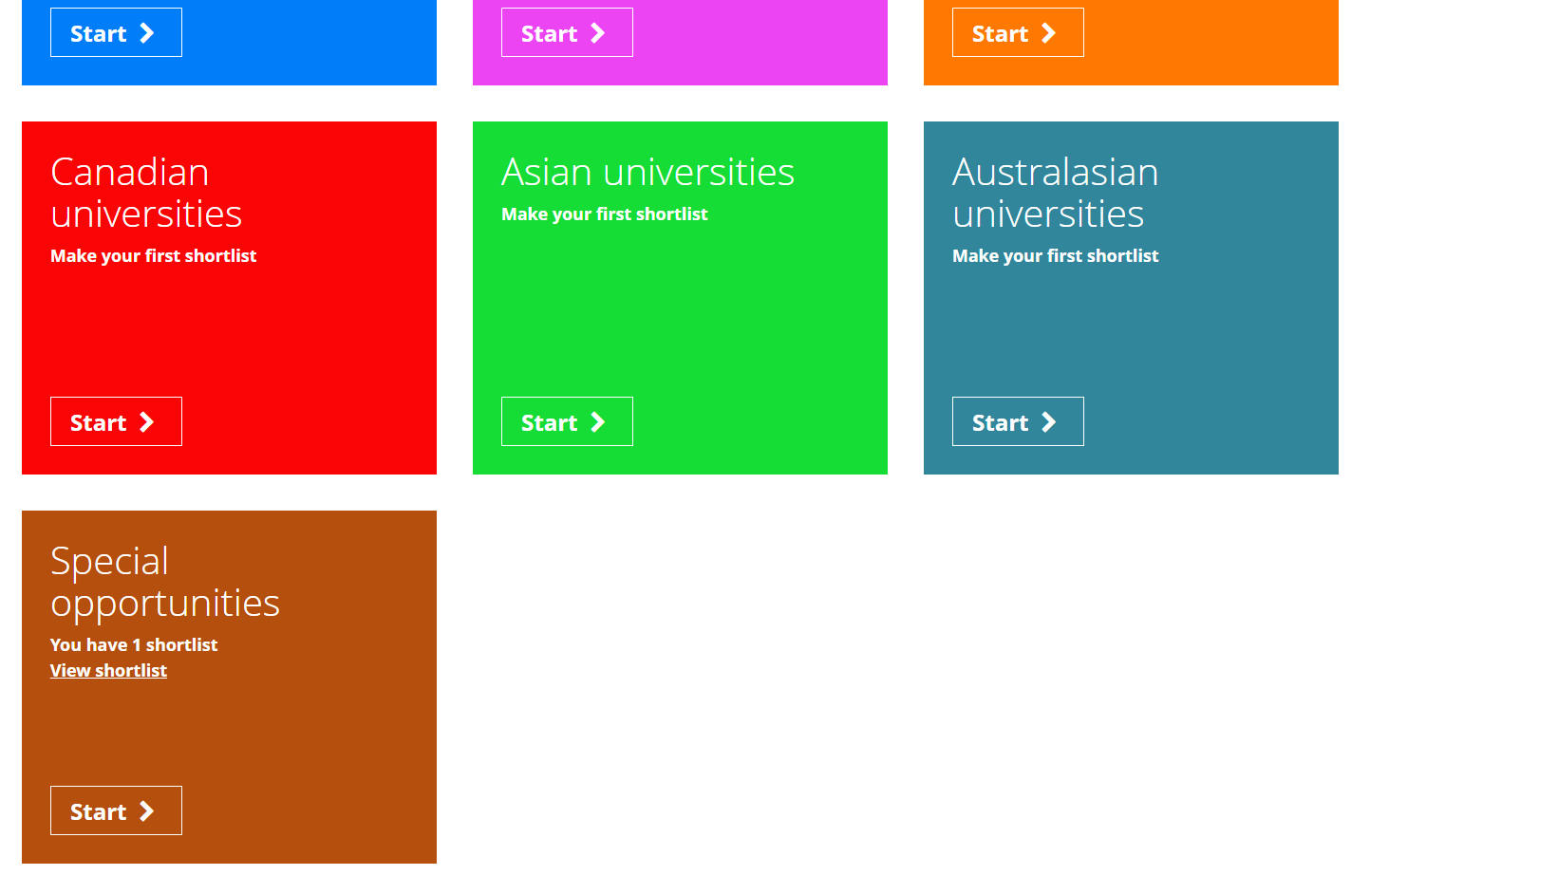
From the student dashboard at unifrog.org/student/home, click the ‘Start’ button on the Special opportunities box.

Slide 4
There are 3 different types of special opportunities:
Scholarships
  Money you don’t have to pay back
Activities
  Summer schools, residentials, other extracurricular activities, and free mentoring
Contextual offers
  When universities lower their entry requirements for students who have met certain criteria

Slide 5
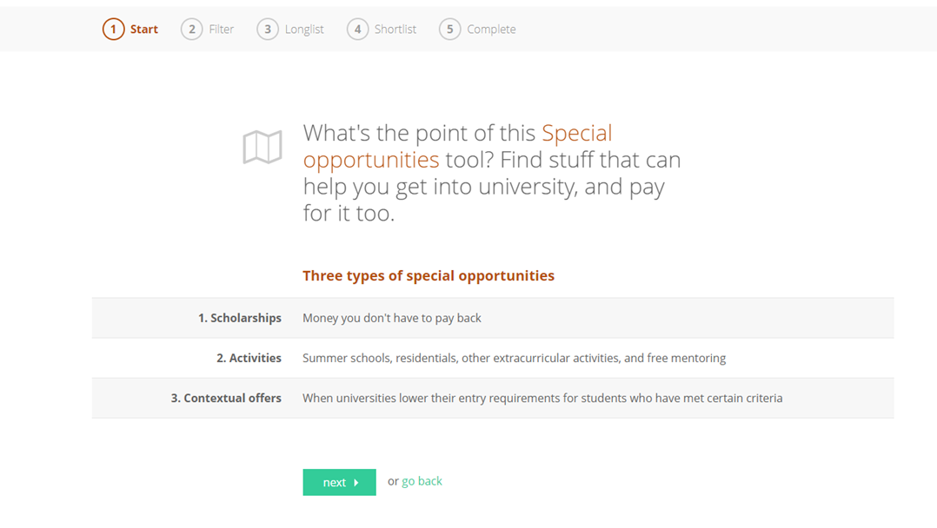
Click on ‘next’ once you’ve finished reading.

Slide 6
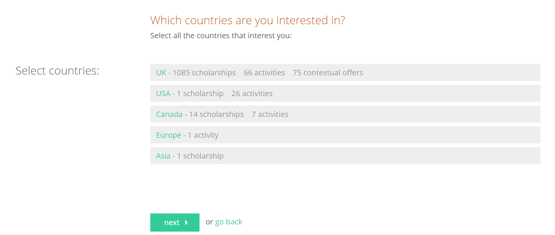
Here, you can select the countries that you’re interested in exploring special opportunities in.
Once you’ve finished choosing, click ‘next’.

Slide 7
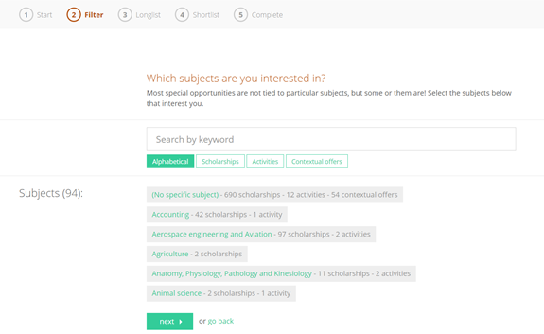
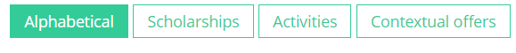
You’ll now be presented with the option to search for a specific special opportunity using the ‘Search by keyword’ box or alternatively you can scroll down the subject list and select the one(s) you’re interested in.
You can also filter by opportunity type using the green tabs under the search box (e.g. so only the subjects with Scholarships are listed).
When you’ve finished choosing, click ‘next’ at the bottom of the screen.

Slide 8
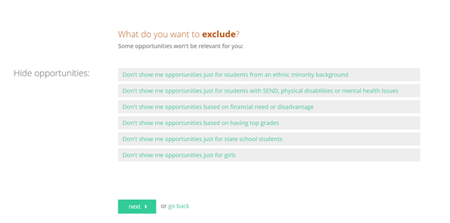
On this page you can choose to exclude the opportunities which aren’t relevant to your personal circumstance.
Select all the ones (if any) that don’t apply to you and then click ‘next’.

Slide 9
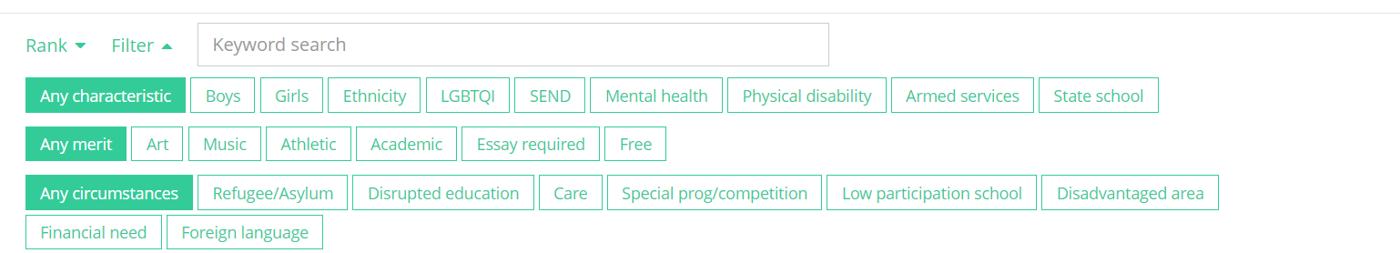
You’ll then be presented with the special opportunities that you have filtered to be relevant to you and your personal circumstances separated by type (e.g. Activities) over three columns.
A breakdown of the opportunity type available and what’s on offer is displayed under each option within these columns. Scroll down to see them all!
You can search by keyword, or sort these further using ‘Rank’ to sort by Eligibility, Deadline, Country and Institution and then ‘Filter’ to narrow this even more.

Slide 10
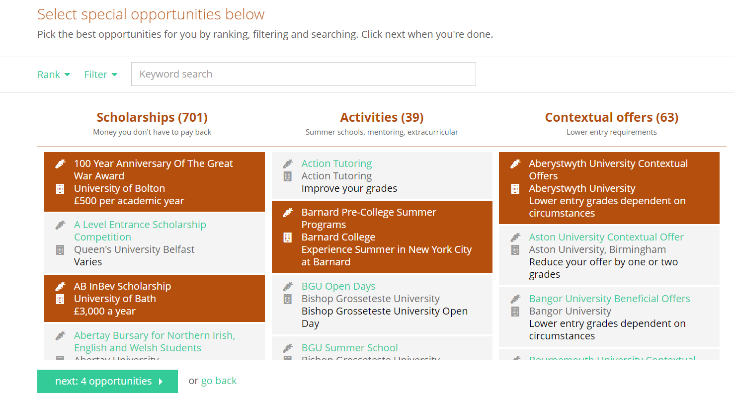
Select/highlight as many opportunities that interest you and when finished, click ‘next:’ towards the bottom of the screen.

Slide 11
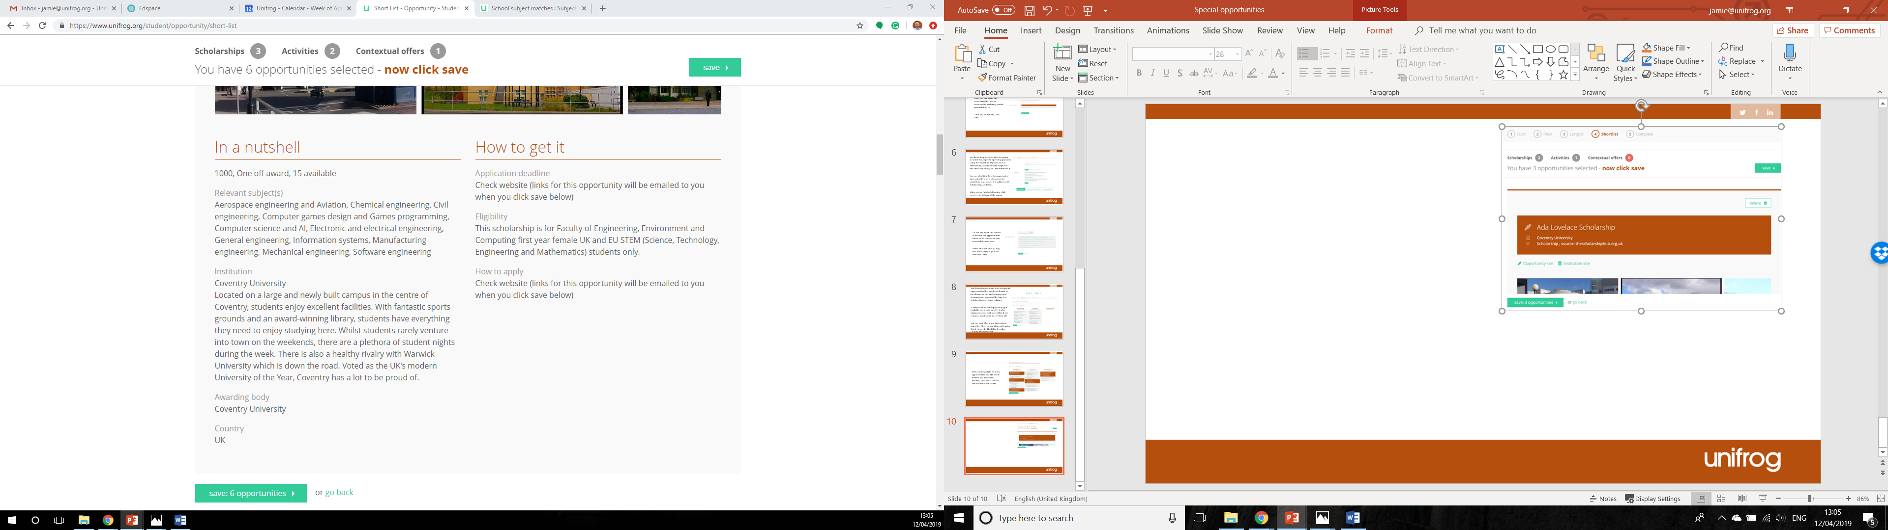
You’ll then be able to see all the opportunities you have selected on this next page. Here, you can scroll through and find out information about what the university is offering, the specific eligibility criteria and how to apply for it.

Slide 12
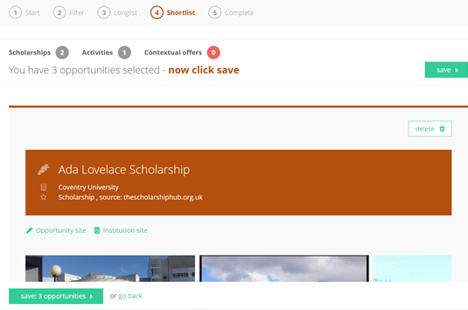
You can also delete from this list any you no longer wish to consider by clicking the ‘delete’ button in the top right corner of each opportunity.
Once you’re happy with your Shortlist, click ‘save:’ at the bottom of the screen.

Slide 13
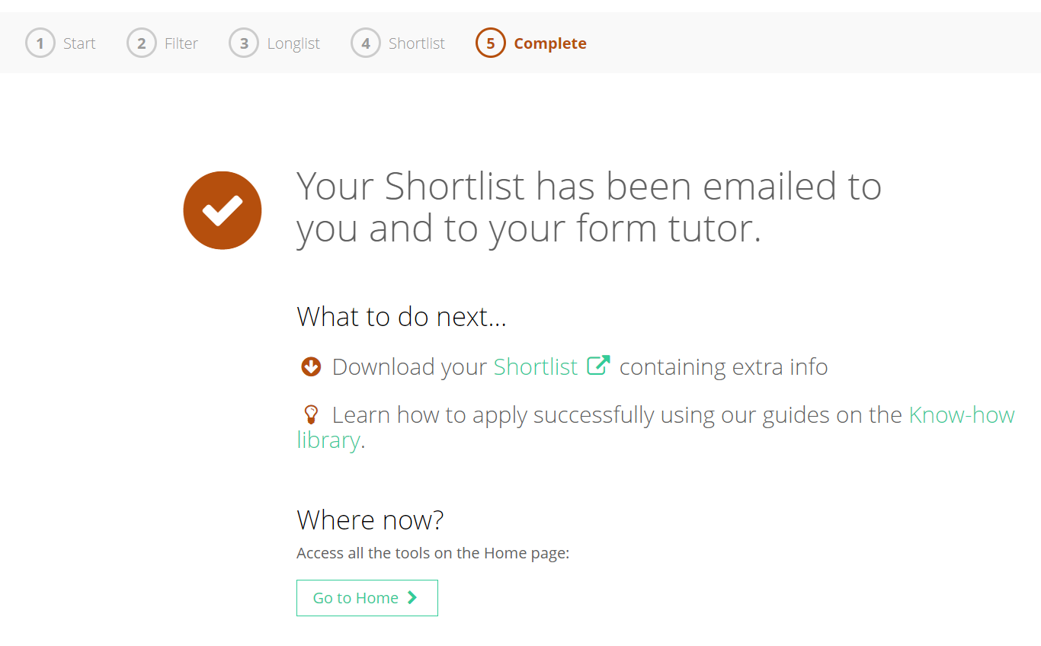
Your Shortlist will then be emailed to you and your form tutor.
Here you also have the option to download your Shortlist with extra info if you need to.

Slide 14


